Slide 1
A Brief Introduction to the R Programming Language

Slide 2
Why R?
R is free
R is the language of statisticians
R can be used on any OS with any hardware
R has unrivaled help resources
R makes the best graphics. Full stop
R code is 100% text-based and scriptable
R is more than a statistics application
R has CRAN
See monkeysuncle.stanford.edu

Slide 3
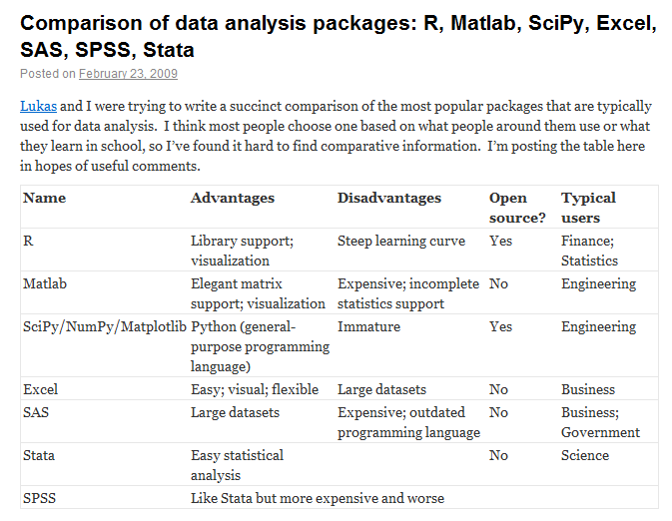
R Compared
From brenocon.com/blog

Slide 4
An Excel Intervention
“We need to talk about your Excel problem . . .”
Advantages:
Excel is tactile
You are already really good at it
It is ubiquitous
Disadvantages:
Cannot handle very large datasets
No clear separation between layers
Not text-based
Prone to unknown errors
Some things are just hard in Excel

Slide 5
[We] must move away from a desktop spaghetti of reporting systems . . .
—Joel Fox, director at Towers Watson
Quoted at theactuary.com

Slide 6
Who is using R?
Beazley
Google
Facebook
Microsoft’s Bing
Lloyd’s
Allianz
ANZ Bank
The New York Times
Academia
etc.

Slide 7
Agenda
The R Environment
Getting Data into R
Using Data
“Help!”
Where R Excels
“It’s Crantastic!”
Do-It-Yourself Functions
“What Next?”

Slide 8
The R Environment
Start RGui
Console
Entering commands,
Auto completion
Menu Bar
Editor windows
getwd(), setwd()
Getting and setting options, options()
Sys.getenv(), Sys.setenv()
Saving and loading workspaces
Start R/RExcel
RStudio

Slide 9
Getting Data into R
Built-in datasets
data()
R/RExcel
read.*()
read.csv()
read.table()
etc.
load()
edit()
fix()
package:RODBC
Exercise

Slide 10
Using Data — Data Types
Vector
Array
Matrix
List
Dataframe
Other more advanced concepts, but good to be aware of
Function
Environment
Pair

Slide 11
Using Data — Vectors and Variables
c()
Assignment operators
Valid names
n:m, seq()
rep()
sample()
factor()
Recycling rule
Every value is a vector — there are no scalars
The L suffix
Operations on vectors
length()
sum()
+, -, *, /

Slide 12
Using Data — Arrays and Matrices
Arrays are multidimensional vectors
They can be any dimension
Arrays and matrices have all elements in the same mode
When they have two dimensions, they are called matrices
Create by setting the dimension attribute of a vector
matrix()
cbind()
rbind()
There are several matrix specific functions
t()
diag()
%*%
solve()

Slide 13
Using Data — Dataframes
Dataframes are like SQL tables
They are really just lists where each column is a vector of the same length
You will work with dataframes often
data.frame()
as.data.frame()
Indexing data frames
merge()
names()
attach()
detach()
with(), within()

Slide 14
“Help!”
help.start()
?
help.search(), ??
args()
str()
search()
Stackoverflow
R-Bloggers
Rseek.org
R Project website
R Journal
Books on R
Ask a colleague

Slide 15
Where R Excels
Large datasets
Summarizing data quickly
Statistics
Graphics
Sweave and the like
*apply() family of functions
Multidimensional data
etc.

Slide 16
“It’s Crantastic!”
Vanilla R
Includes 7 packages: base, methods, datasets, utils, grDevices, graphics, stats
Has over 2,000 functions
Sometimes we need more?
Packages are add-ins for R written by other R users
You get packages from CRAN
There are over 3,000 packages on CRAN
How can you tell if a package is good?
crantastic.org
install.packages(), installed.packages(), library(), require()
help(package = package), ls.str()
Beazley specific packages?, “Writing R Extensions”
Some of our favorites:
ggplot2, reshape2, actuar, ChainLadder

Slide 17
Do-It-Yourself Functions
my.first <- function() {
message('This is my first function.')
}
Valid names
Arguments
Default values for arguments
Functions are objects
Functions are closures
Return values
Try some more . . .

Slide 18
What Next?
Think of ways to use R in your work
Ask others to help you get started
Read a book or two
Go to the LondonR useR! group meeting, September 7
Other meetings like this?
External training?
Pick a project and do it in R parallel to Excel

